Slide 1
Conditions of Change Change Models Wildcard
ProSeminar 2 EDCI-888
Majd Alomar
February 23, 2014

Slide 2
Conditions of Change
Founded by Donald P Ely, a leading theorist in the field of Instructional Technology

Slide 3
Overview
Ely published two papers which emphasized the Conditions of Change:
Creating the Conditions for Change published in 1976 and emphasized the importance of environmental conditions on the change process.
Conditions that Facilitate the Implementation of Educational Technology Innovations published in 1990 and included implementing technology innovations in educational settings.

Slide 4
Eight Conditions of Change
(Williams & Turek, 2010)

Slide 5
What They Have Said About The Model
“Ely’s Condition of Change Model is arguably the broadest and most far-reaching of the classical change models.” (Ellsworth, 2000)
“As a framework of environmental conditions it seeks to represent the context within which the constructs defined by the other classical models operate.” (Ellsworth, 2000)

Slide 6
How To Use The Model
According to Williams and Turek (2010) Ely suggests, to use it as a "needs assessment" (Ely, 1990).
The use of Ely's conditions as a diagnostic tool are also encouraged throughout the entire process. (Williams & Turek, 2010)

Slide 7
How To Use The Model
Using the Conditions of Change model framework prior, during, and on an ongoing basis can provide change agents with valuable information. (Williams & Turek, 2010)
According to Ely, “The goal is to attain each of the conditions in implementation” (Ellsworth, 2000; Ely, 1990)

Slide 8
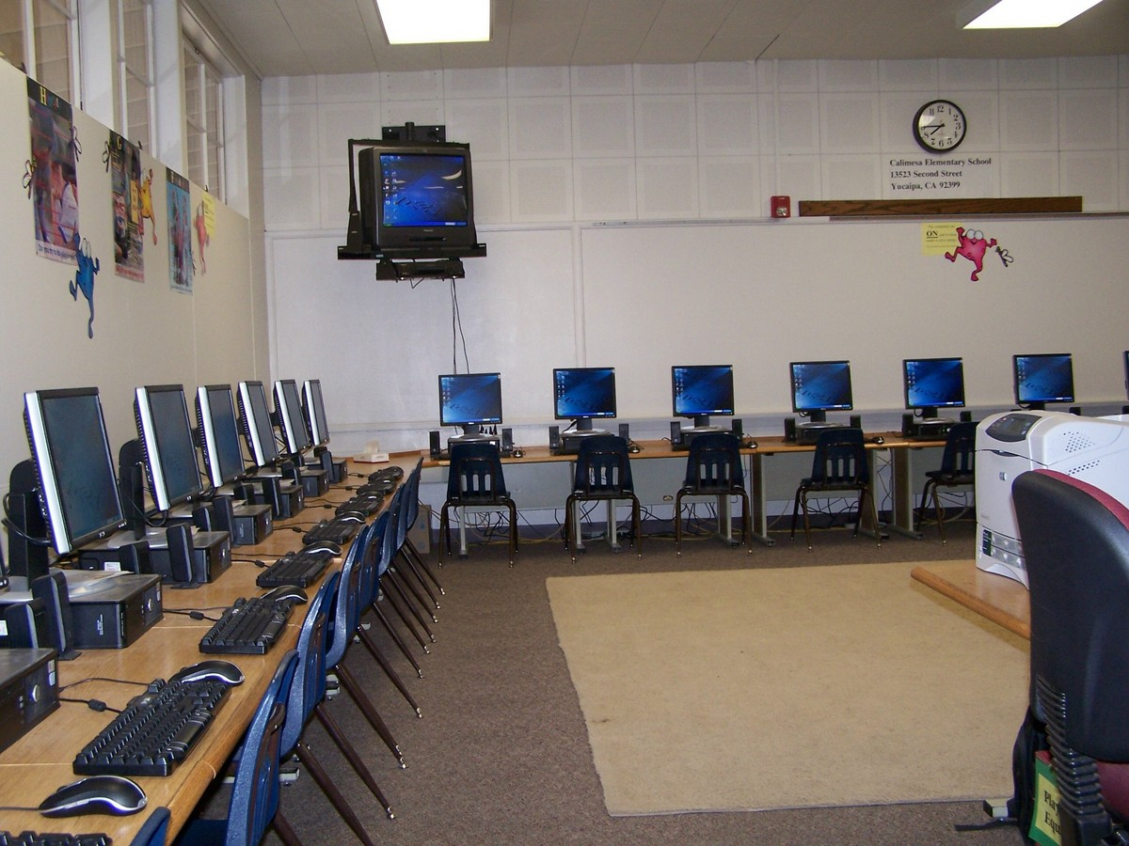
Applying The Model
For the purpose of this assignment, the model is applied to a traditional school that does not have a computer lab. As the technology coordinator, I use Ely’s Change Model.

Slide 9
1. Dissatisfaction With The Status Quo
The degree of dissatisfaction needs to be measured. If the majority is happy with the traditional school and do not feel the need to have a computer lab, then implementing this change will be met with resistance.

Slide 10
2. Sufficient Knowledge And Skills
The technology coordinator, teachers and all those involved in using the new computer lab must have the knowledge and skills to implement the change.

Slide 11
3. Availability Of Resources
Are all the required resources available to implement the change? Some resources needed include
Hardware
Software
Audio/Visual media
General funding
Instructional Supplies
Technical Support

Slide 12
4. Availability Of Time
How much time do teachers need to adopt the new computer lab resource to their instruction?
Teachers will need time for the following:
Professional development
Adjusting lesson plans
Updating curriculum
Personal reflection

Slide 13
5. Reward Or Incentives
Provide a reward for those teachers that adopt the new computer lab and adjust their lessons according to the new change.

Slide 14
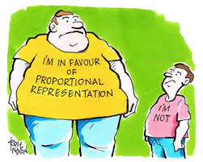
6. Participation
Encourage the participation of the teachers, technology experts and superintendent and insure that all of their ideas and opinions are represented in the new change.

Slide 15
7. Commitment
Make sure the administrators, superintendent and teachers show a long term commitment to the implementation of the change.

Slide 16
8. Leadership Is Evident
It must be made clear to everyone who is leading this change and who is responsible for the implementation of the Computer lab. The leader is responsible for the following:
Providing encouragement
Insure training is delivered
Insure that resources are available

Slide 17
References
Anderson, J., & Rainie, L. (2012, July 27). The Future of Higher Education. Pew Research Internet Project. Retrieved February 23, 2014, fromhttp://www.pewinternet.org/2012/07/27/the-future-of-higher-education/
Ellsworth, J.B. (2000). Surviving change: a survey of educational change models. Syracuse, N.Y.: Clearninghouse on Information & Technology, Syracuse University.
TEDxDesMoines - Angela Maiers - You Matter http://www.youtube.com/watch?feature=player_embedded&v=7FHdHUzRnms#!
Williams, M. & Turek, W. (2010, February 12). Overview – Ely’s Conditions of Change. Ely’s Conditions of Change. Retrieved February 23, 2014, from https://sites.google.com/site/elysconditionsofchange/history

