Slide 1
The Great Media Debate
Majd Alomar
February/09/2014

Slide 2
The Debate
Is Media a vehicle for learning?
OR
Do Media influence learning?

Slide 3
Is Media a vehicle for learning?
Any reasonable interpretation of an instructional medium such as Media should not be looked at as merely a vehicle. Media are combinations of technology, task, and context (Jonassen, Campbel, Davidson, 1994: Kozma 1994)

Slide 4
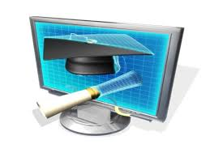
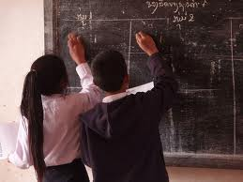
It is time to rephrase the question
“Perhaps it is time to go beyond our concern with "proving" that media "cause" learning so that we can begin to explore the question in more complex ways” (Kozma, 1994).
How do media affect learning?

Slide 5
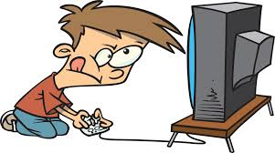
How do media affect learning?
Media “possess particular characteristics that make them both more and less suitable for the accomplishment of certain kinds of learning tasks” (Kozma, 1994).

Slide 6
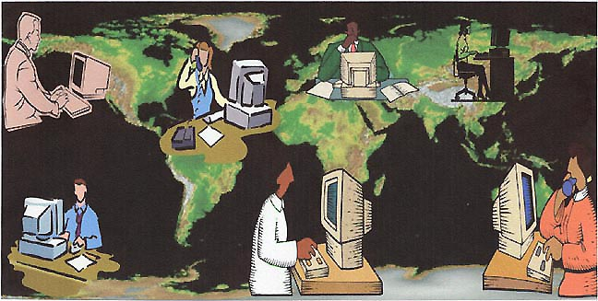
How do media affect learning?
Media can globalize learning and give learners a new and different perspective

Slide 7
How do media affect learning?
Media can affect student engagement (Boulianne, 2009)
Media can affect motivation (Forte & Guzdial, 2004)
Media can cause distraction (Sun & Cheng, 2007)
Media can support individualized learning (Daniel, 1999)

Slide 8
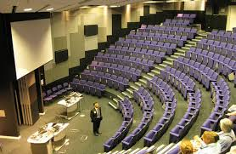
In search of the right question
“If we move from "Do media influence learning?" to "In what ways can we use the capabilities of media to influence learning for particular students, tasks, and situations?" we will both advance the development of our field and contribute to the improvement of teaching and learning” (Kozma, 1994).

Slide 9
The Debate Continues
“…as instructional designers and educators we should shift the debate and the practice of instruction design from instruction and media centered to a learner centered conception of learning” (Jonassen, Campbell, Davidson, 1994).
“This debate should focus less on the characteristics and attributes of media for conveying knowledge and more on the attributes of the human learner involved in learning and ultimately the construction of human knowledge” (Jonassen, Campbell, Davidson, 1994).

Slide 10
References
Boulianne, S. (2009). Does Internet use affect engagement? A meta-analysis of research. political communication, 26(2), 193-211.
Daniel, J. S. (1999). Mega-universities and knowledge media: Technology strategies for higher education. New York: Kogan Page.
Forte, A., & Guzdial, M. (2004, January). Computers for communication, not calculation: Media as a motivation and context for learning. In System Sciences, 2004. Proceedings of the 37th Annual Hawaii International Conference on (pp. 10-pp). IEEE.
Jonassen, D. H., Campbell, J. P., & Davidson, M. E. (1994). Learningwith media: Restructuring the debate. Educational technology research and development, 42(2), 31-39.
Kozma, Robert B. (1994), The Influence of Media on Learning: The Debate Continues, School Library Media Research, Volume 22, Number 4
Sun, P. C., & Cheng, H. K. (2007). The design of instructional multimedia in e-Learning: A Media Richness Theory-based approach. Computers & Education, 49(3), 662-676.

