Slide 1
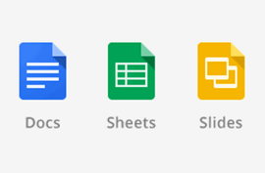
Group A (Howida, Rama, Majd)

Slide 2
Google Docs
Collaborate on lesson plans
Keep a record on meeting notes
Create a shared lesson plan repository
Notes:
1- Work on the same lesson at the same time
2- Take meeting notes in Google docs and share it with colleagues
3- Create a folder for your grade level to share resources, Store lesson plans in this folder for students’ to access them
4- Have students work collaborativly from anywhere. Give them feedback on their work. Use the revision history to see who has done what
5- Share settings on google docs allow publishing the students work within the class, within the student district or making it public on the web.
6- Translating letters, newsletters so on to parents.

Slide 3
Google Docs
Improve the writing process
Publish student work
Translate letters to parents (Go to Tools > Translate Document)

Slide 4
Google Sheets
Track signups (signup for meetings)
Personalize flashcards (Go to Insert > Gadget > Flashcards Gadget)

Slide 5
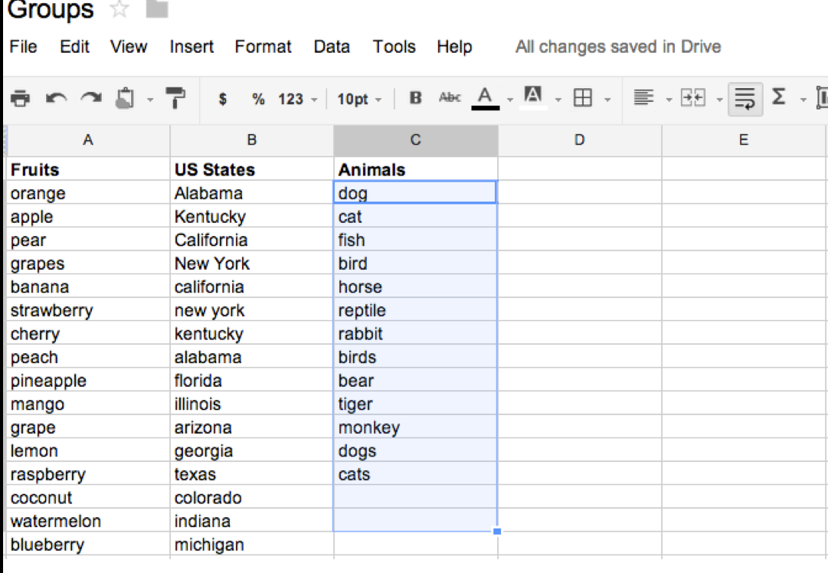
Google Sheets
Collect data, share and analyze it
Brainstorm groups names by activating sets within Google sheets
Notes:
1- using charts and graphs gadgets
2- Such as US states, Animals, Food, etc.

Slide 6
Google Slides
Create engaging presentations

Slide 7
Assignment Discussion
Discuss with your group 2-3 main points from DE 1, then share it with the class:
Group A (Howida, Rama, Majd) ➔ Question 1 (MOOCs)
Group B (Allison & Lia) ➔ Question 4 (Distance Education in Higher Education)
Group C (Shaun & Paul) ➔ Question 3 (LMS)
Group D (Leigh & DeeAnn) ➔ Question 2 (Distance Education in K-12 Schools)
Group E (Jamie & Ali) ➔ Question 5 (Mobile Learning in Online Teaching)

